Slide 1
Climate Change
Eric Zhou

Slide 2
Hypothesis
Very vague hypothesis
Hypothesis
Around 0.8 for correlation between carbon levels and global temperature
Around 0.6 correlation between carbon/temperature and related weather/climate patterns. Probably low correlation between many effects and carbon/temperature.

Slide 3
Gathering Data
CO2 Levels: https://github.com/datasets/co2-ppm-daily
Temperature: https://datahub.io/core/global-temp#readme
Hurricanes: https://www.ncei.noaa.gov/data/international-best-track-archive-for-climate-stewardship-ibtracs/v04r00/access/csv/
pH: ftp://ftp.nodc.noaa.gov/pub/data.nodc/ncei/ocads/data/0145164/
Sea Level: https://github.com/datasets/sea-level-rise
Wildfires: https://gist.github.com/lazarogamio/d64e0d04b1ce1f2a3bd08db7526fa632
Notes:
These are the sources for my data and all of them were found through me searching for data csv files online

Slide 4
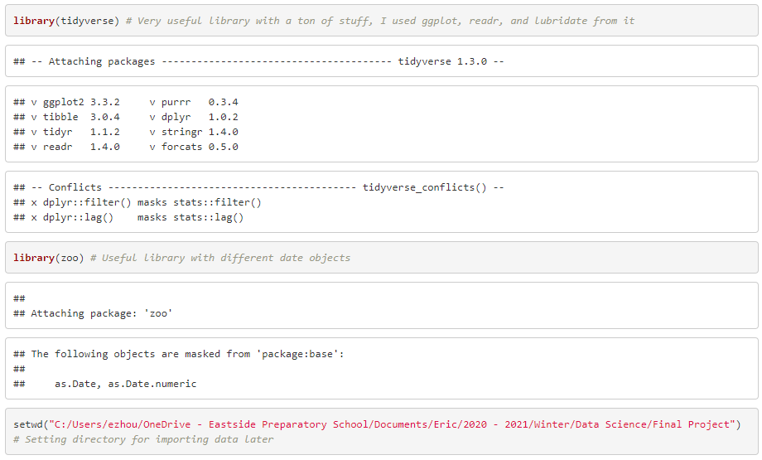
Basic Setup

Slide 5
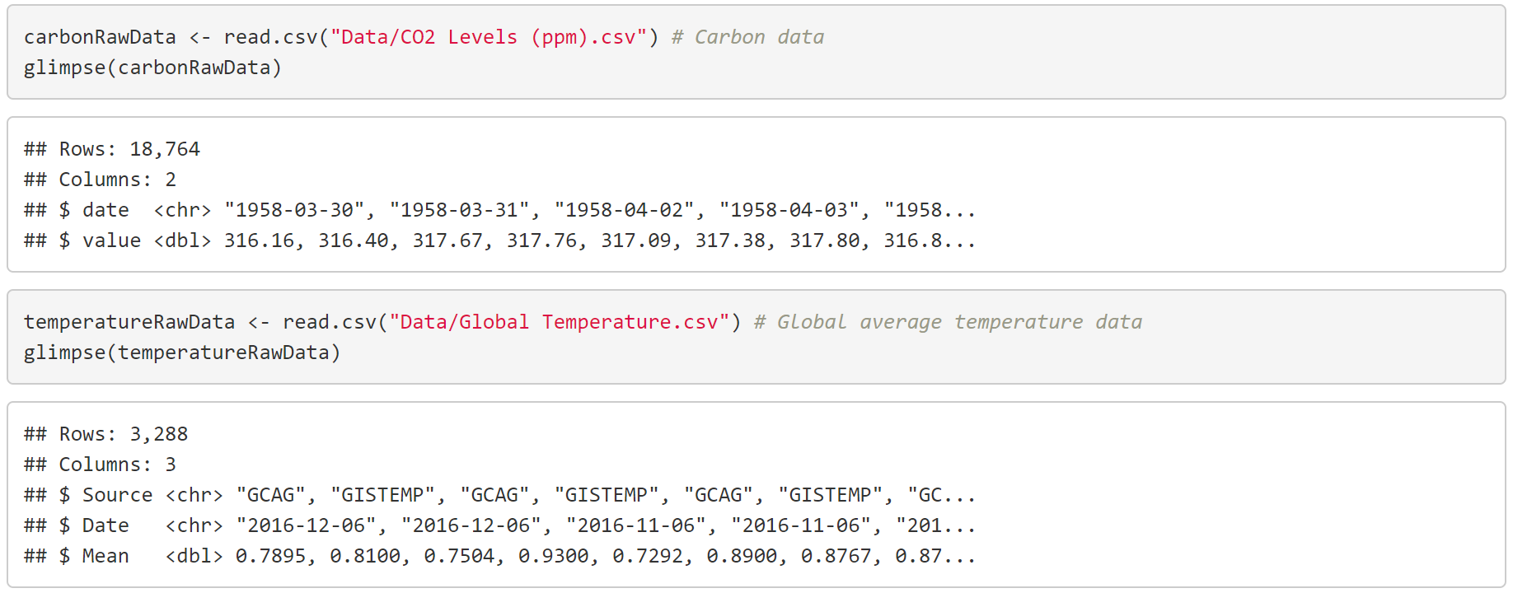
Carbon and Temperature Data
Notes:
I first imported the Carbon and Temperature data and used glimpse to see what the datasets looked like. They were both pretty simple and shared the date column which is very important.

Slide 6
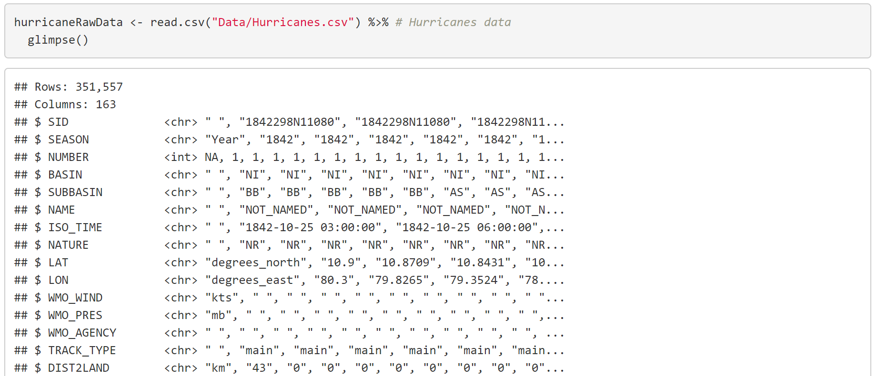
Hurricane Data
Notes:
Just a note, the way my presentation is organized follows the order I did things for the project. So next, I looked at Hurricane data, which was the first weather pattern I wanted to look at. This dataset had a ton more data, with 163 columns and 351,557 rows. After looking through the variables, I found SEASON is basically the year the hurricane occurred, which could be used as a date, and I thought that STORM_SPEED was an interesting column I could look at.

Slide 7
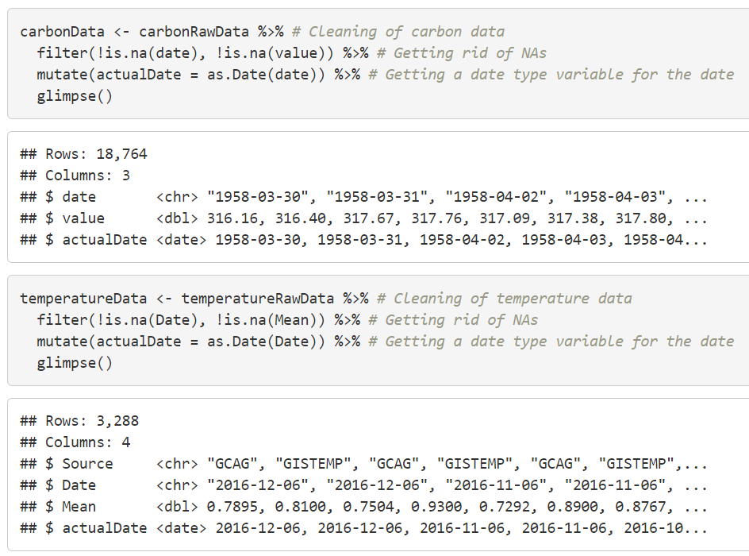
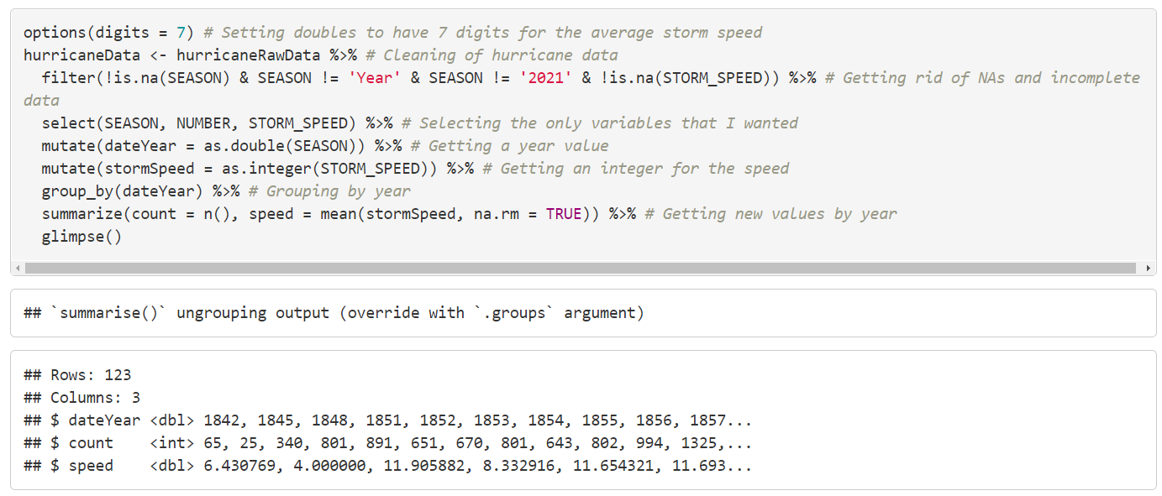
Data Cleaning
Carbon and Temperature:
Hurricane:
Notes:
For carbon and temperature, I just filtered out NA values and created a Date type variable. For hurricane, I filtered out incomplete data and NAs, selected the only columns I wanted, got a year variable. After that, I grouped by year and created a count, which is just the number of hurricanes in that year, and the mean speed.

Slide 8
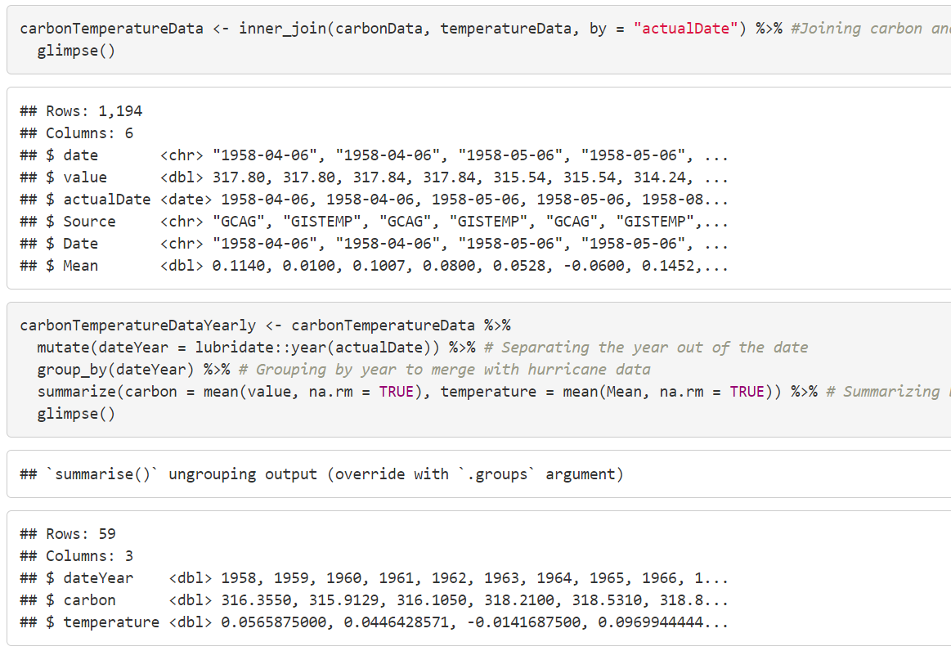
Joining Carbon and Temperature
Notes:
I used inner_join so that only dates with both carbon and temperature are joined together, grouping them by date, which is why date was important to have. Next, I used lubridate to extract the year from the date and created a dataset by year to merge with the hurricane data. One problem is that the amount of data left at the end was a bit low, with only 59 rows. This makes sense since 59 years is a long time, but that’s not a lot of data.

Slide 9
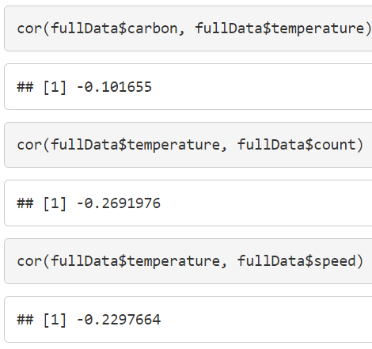
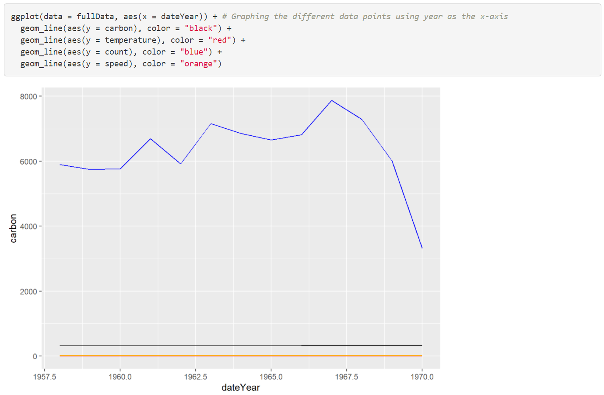
Joining with Hurricane and Fail
Notes:
Next, I joined that dataset with the hurricane data by year, and now I had the first full dataset. However, I only had 13 rows of data left which is kind of a problem. The graph is not very helpful but it is clear that there was so little data that no correlation could be found.

Slide 10
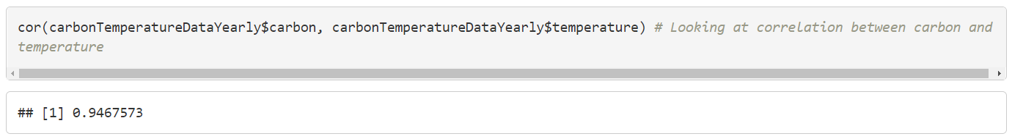
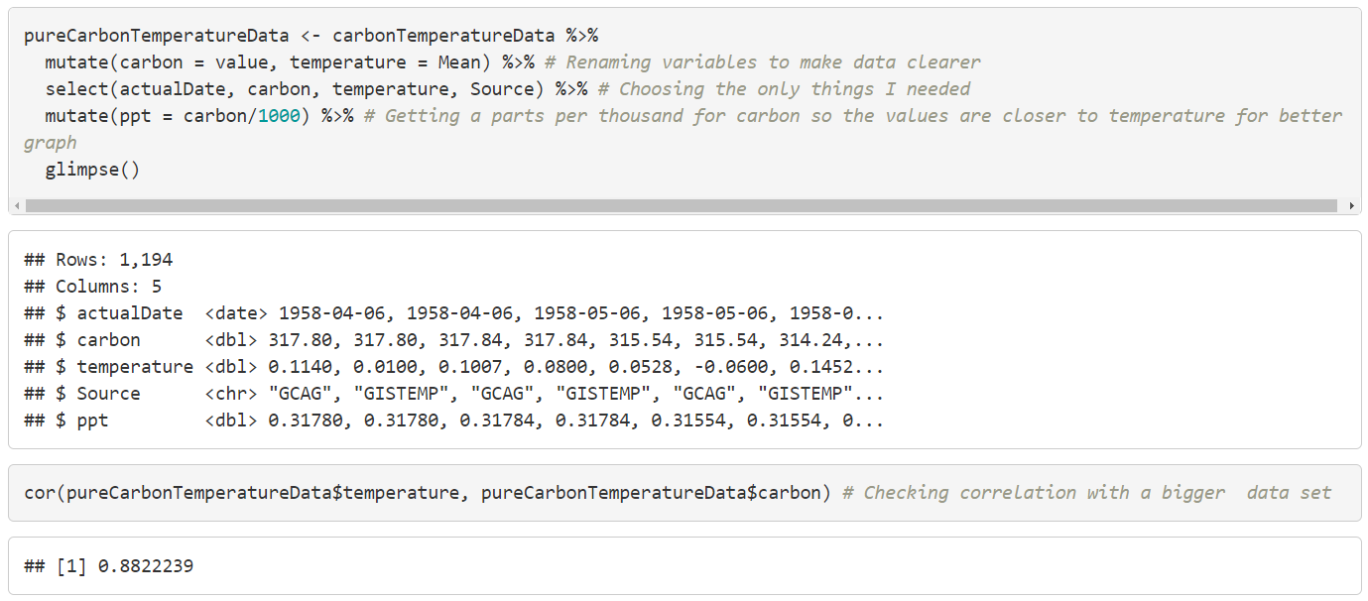
Carbon and Temperature
Notes:
I also looked at the correlation between carbon and temperature in the yearly data and I found that the correlation was actually really high. After seeing this, I decided to focus on carbon and temperature for now and add some effect later. I created a new dataset, renaming variables, selecting variables, and looking at the correlation for this new big dataset and it was still pretty high.

Slide 11
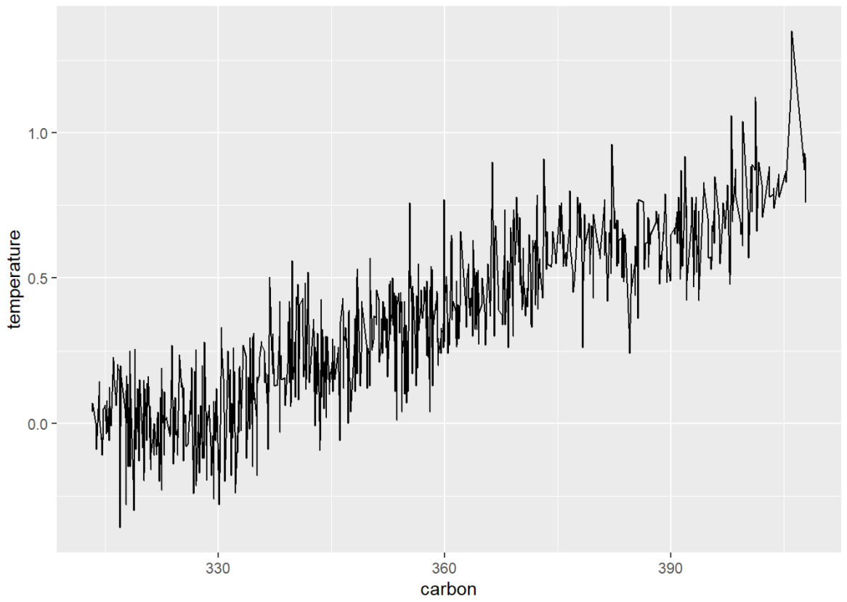
Carbon and Temperature Graph
Notes:
Graphed temperature in relation to carbon. Clearly there are many oscillations but there is a clear linear looking positive trend.

Slide 12
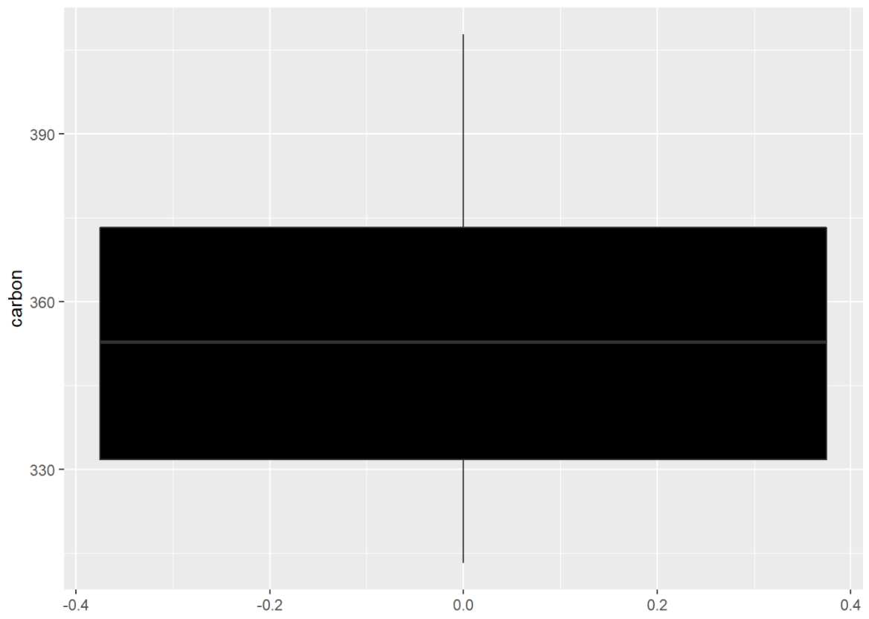
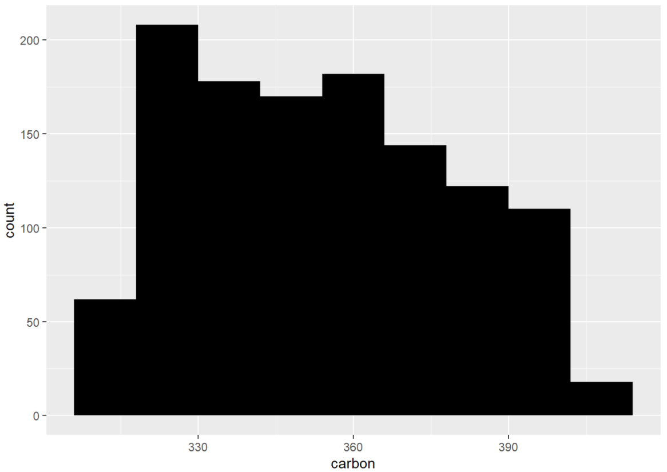
Normality and Outliers for Carbon
Notes:
The boxplot shows no outliers, and the histogram shows the data is pretty normal although it does lean to the left a bit.

Slide 13
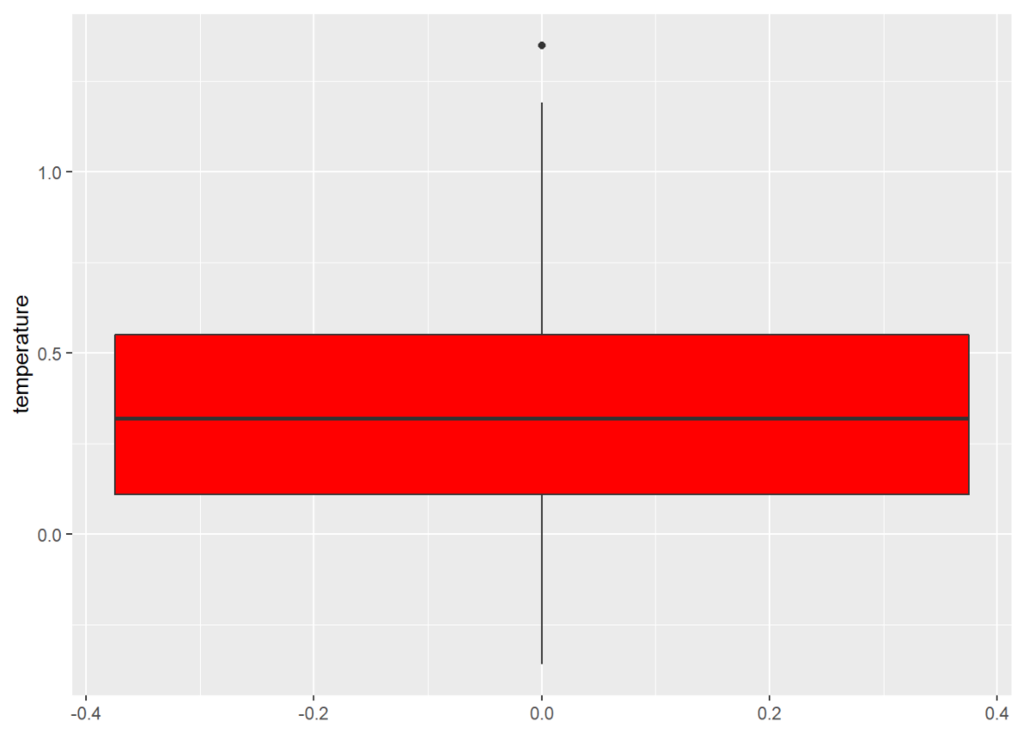
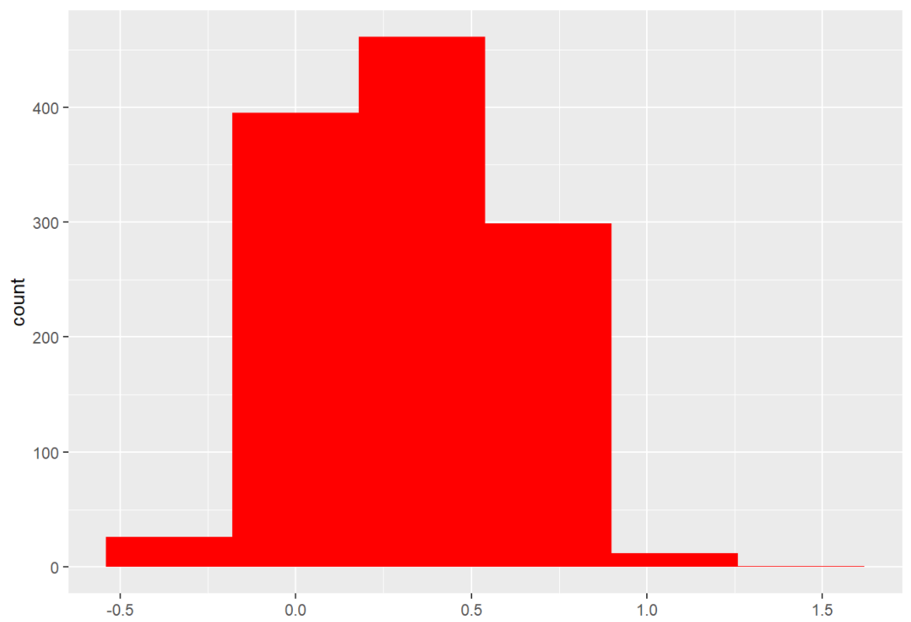
Normality and Outliers for Temperature
Notes:
The boxplot shows one outlier which I filtered out later by filtering out values greater than 1.25, and the histogram shows the data is pretty normal although it also leans left a bit.

Slide 14
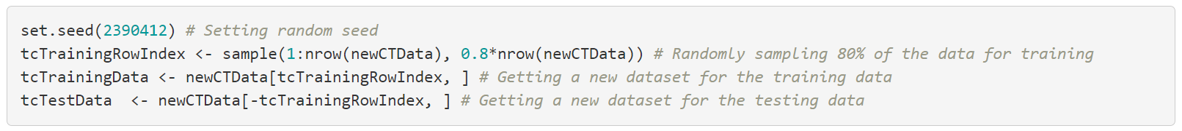
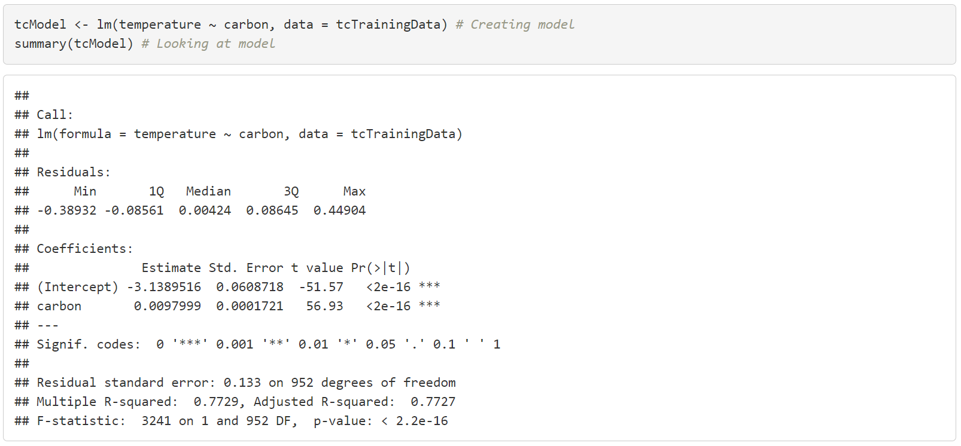
Linear Regression Model
Notes:
Next, I split the new data into training set and testing set and created a model with the training data. R-squared is about 0.77 which is pretty good. Median residual is 0.00424 which is really low. Also, the p-value is really low so this model seems to be a pretty good model.

Slide 15
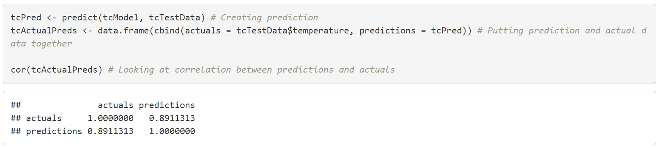
Testing Model
Notes:
There is a about 89% correlation between the predictions and actual results which I think is really good. In general this model should continue to predict temperature based on carbon with decent accuracy in the future unless a different green house gas starts having a larger effect.

Slide 16
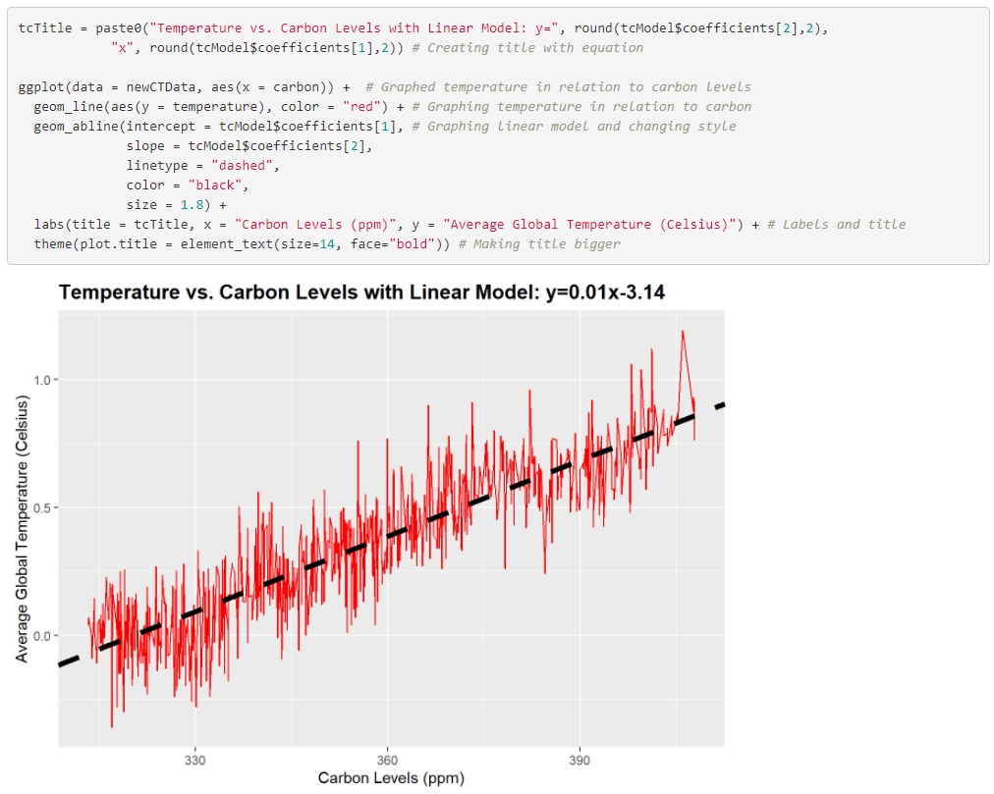
Model Graph
Notes:
Graph looks pretty good, the prediction is clearly following the trend of the actual graph.

Slide 17
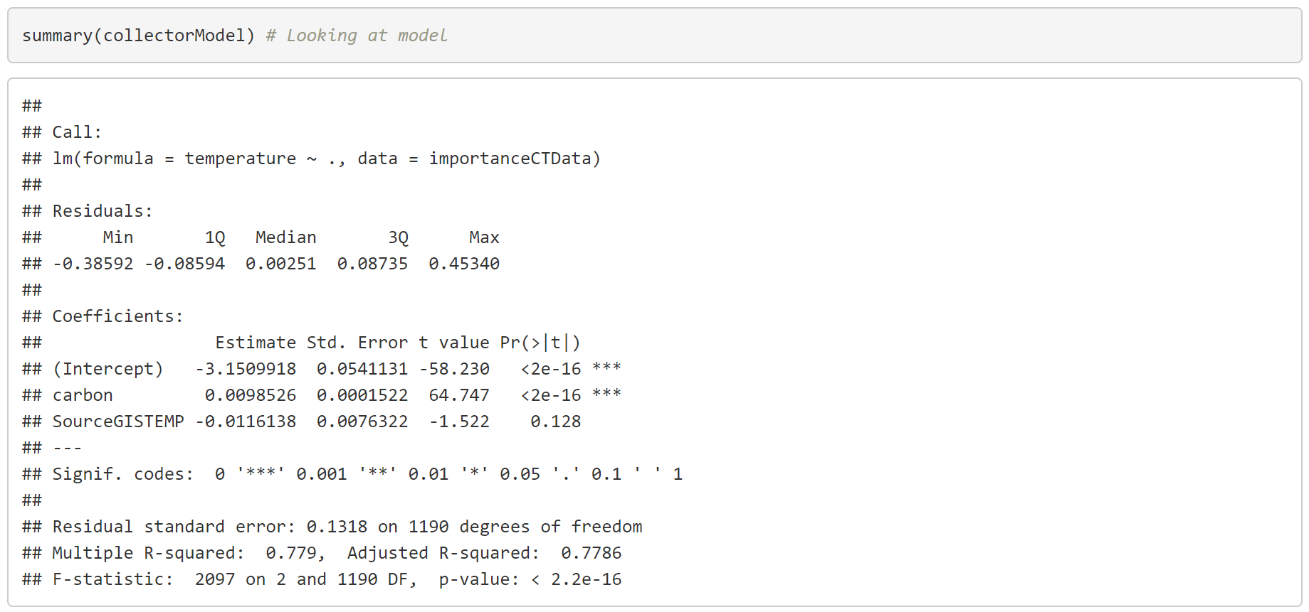
Variable Importance Testing and Conclusion
Notes:
I added the source back into the dataset and made a new model looking if it had an impact. With this change the Median residual dropped by about 0.002 and the R-squared increased by about 0.007 which is barely better so not something that has a huge impact. This makes sense as the reason two different data collectors were used was for different time periods rather than something that might have a larger impact.

Slide 18
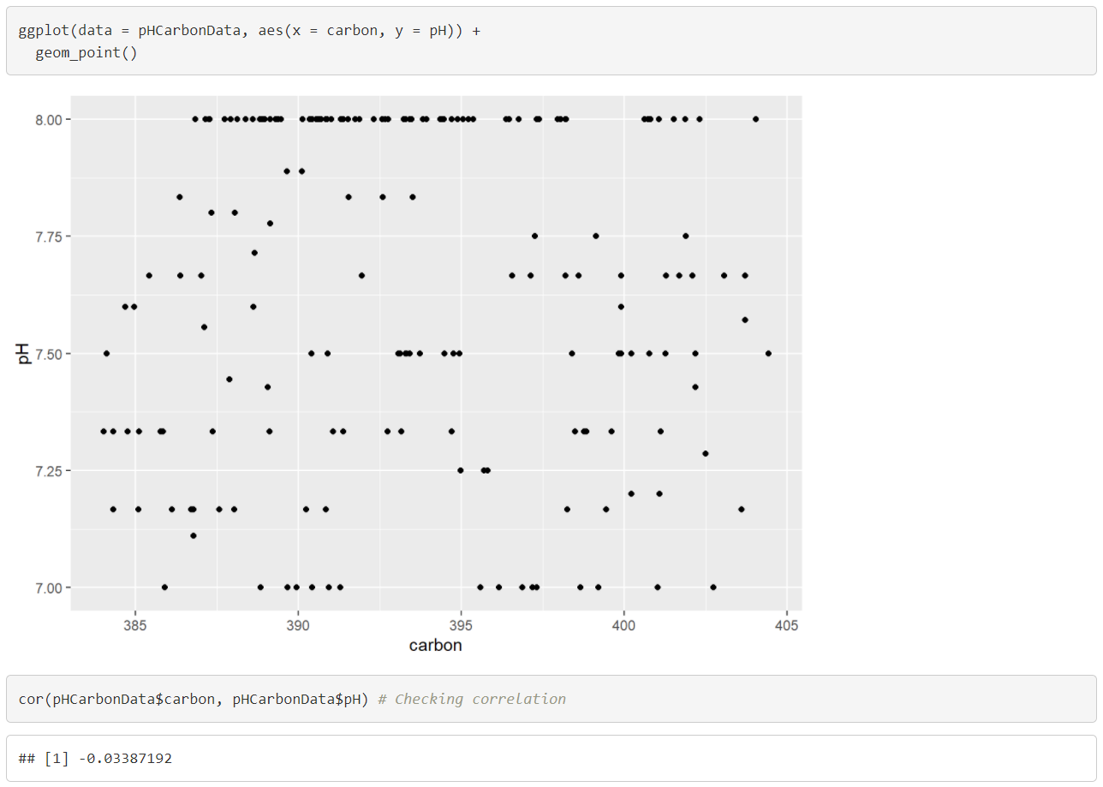
Fail #2: pH
Notes:
For these fails, I’m just going to go through them really fast. Obviously, I did data cleaning and joining beforehand but I’m not going to show it in this presentation. Clearly, there are a lot of points on 8.00 and the rest are pretty scattered, not following the upward trend of carbon, the correlation is also really close to 0.

Slide 19
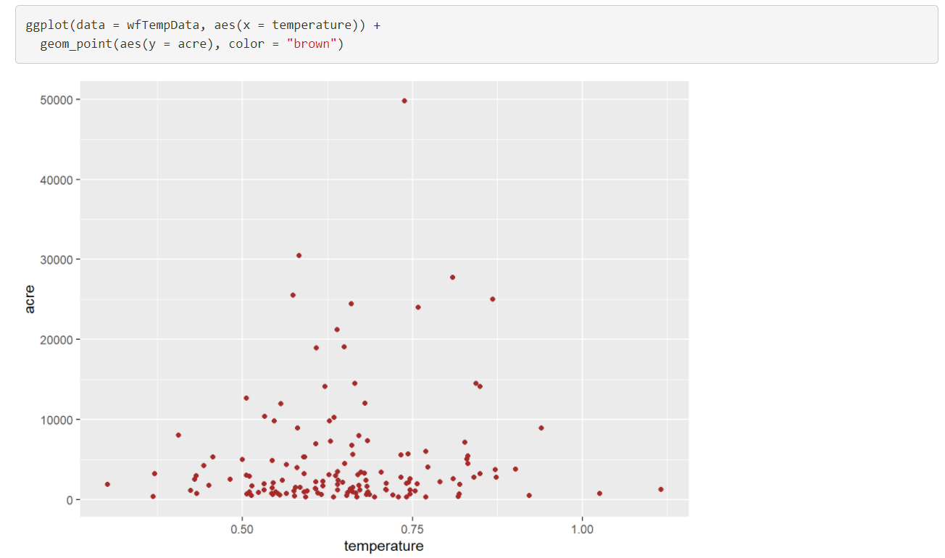
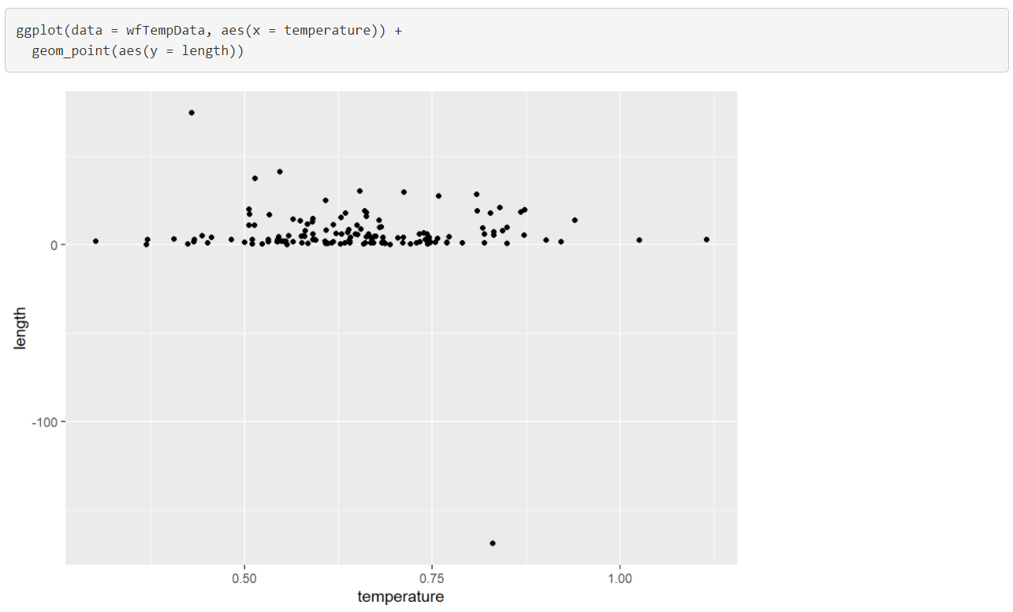
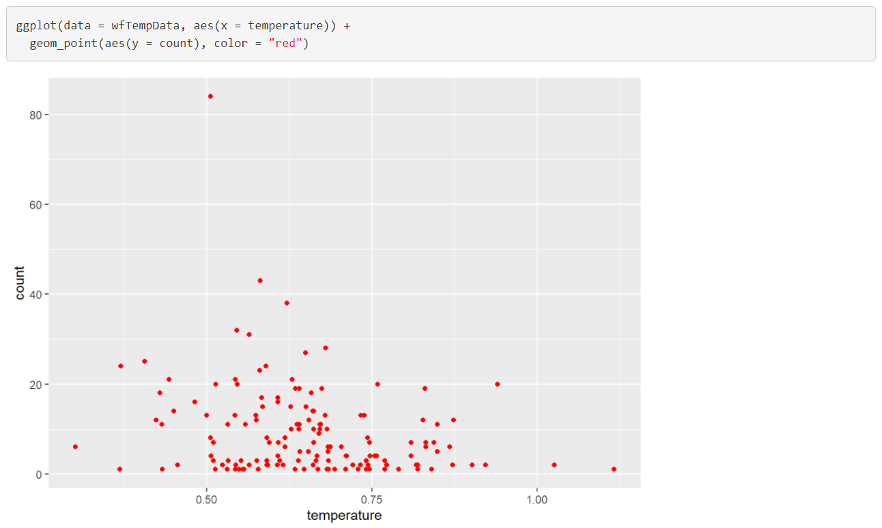
Fail #3: Wildfire
Notes:
For this set, I checked three variables, length of fires, acres burnt, and number of fires. Points are concentrated like a flat line, with other points being scattered pretty randomly, not matching temperature’s upwards trend. All correlation were close to 0, the furthest was only around -0.24.

Slide 20
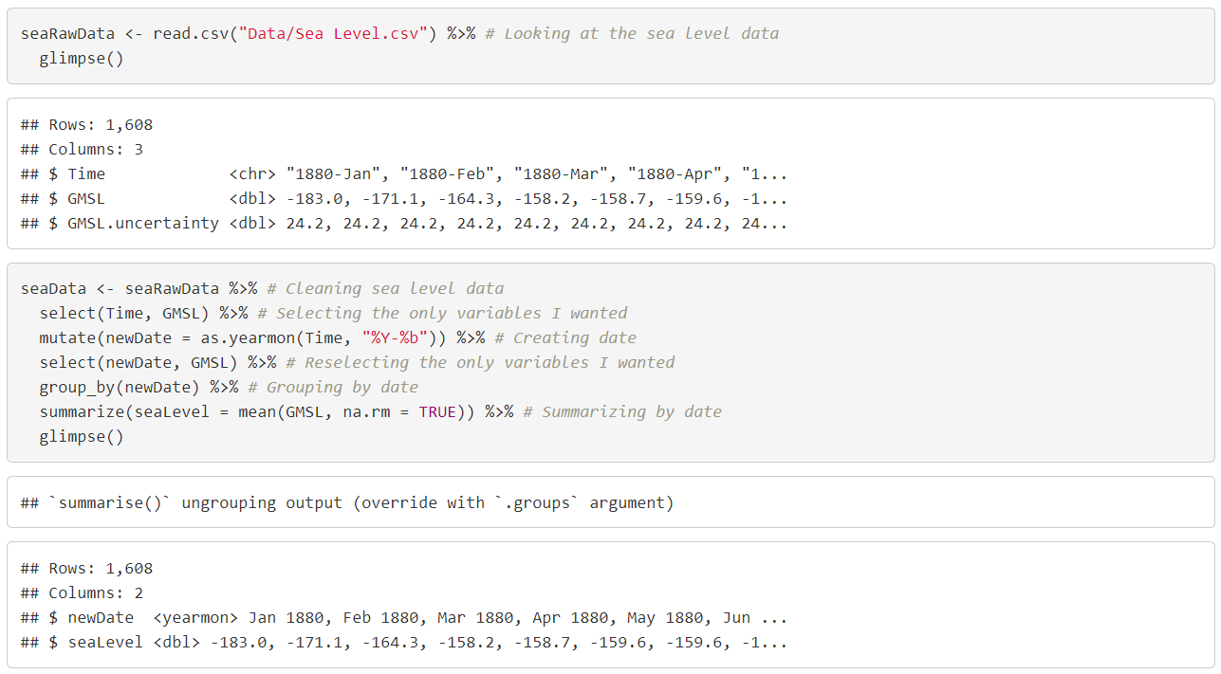
Sea Level Data and Cleaning
Notes:
I imported the sea level data, and everything looked pretty good. The only thing was the date only had a year and a month and the R date object could not just take a year and month. The zoo library I imported at the beginning allows me to create an object called yearmon, which is just a year and a month. I did some simple data cleaning again, selecting, creating yearmon object, grouping, and summarizing. I also made a new temperature dataset with the yearmon object and grouping by it.

Slide 21
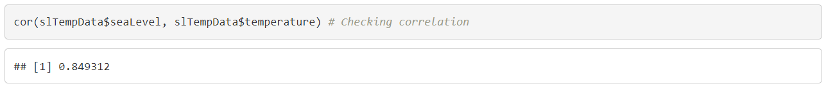
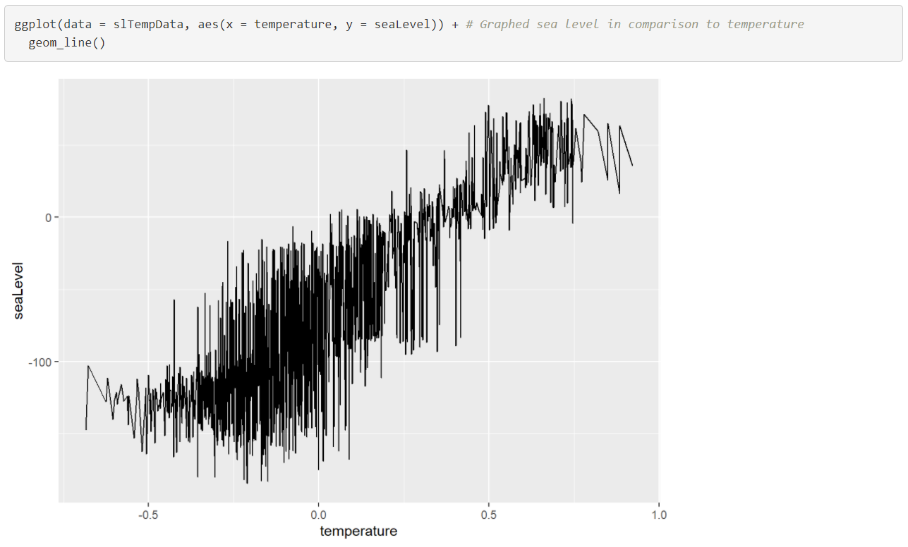
Temperature and Sea Level Correlation and Graph
Notes:
After joining by the yearmon, I checked the correlation and the graph. The correlation is pretty high, at around 0.85. The graph also had a ton of oscilations, especially around -0.5 to 0, but there was a clear upwards trend that looked linear.

Slide 22
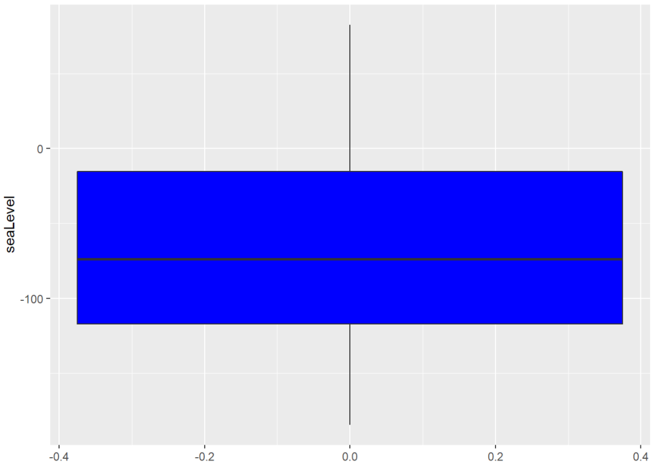
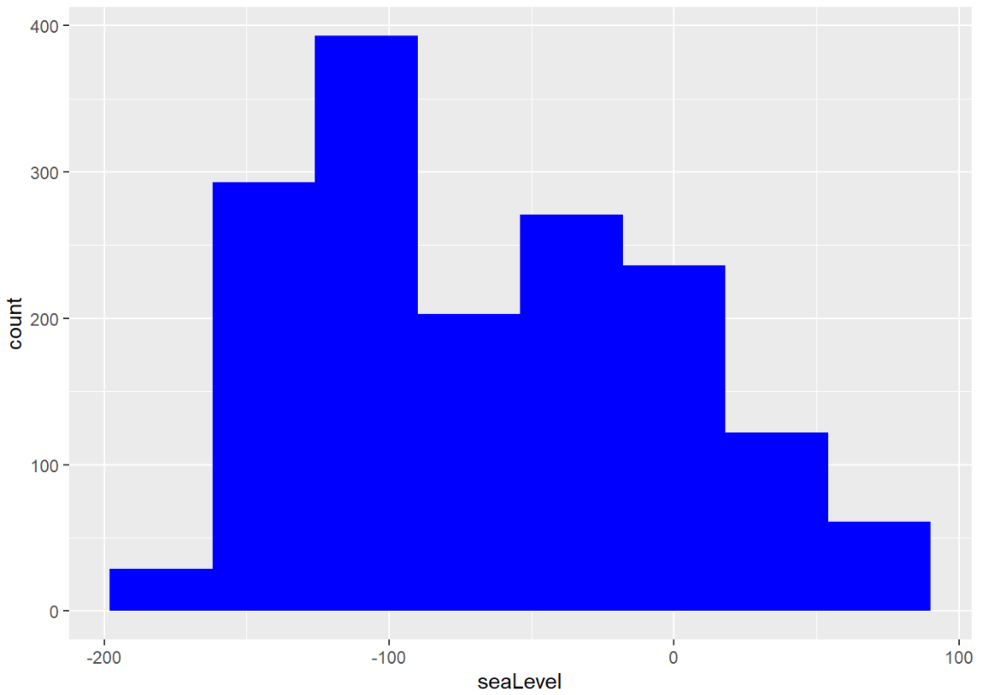
Normality and Outliers for Sea Level
Notes:
There are no outliers and the distribution is pretty normal, although there is a dip in the middle and it is slightly more to the left.

Slide 23
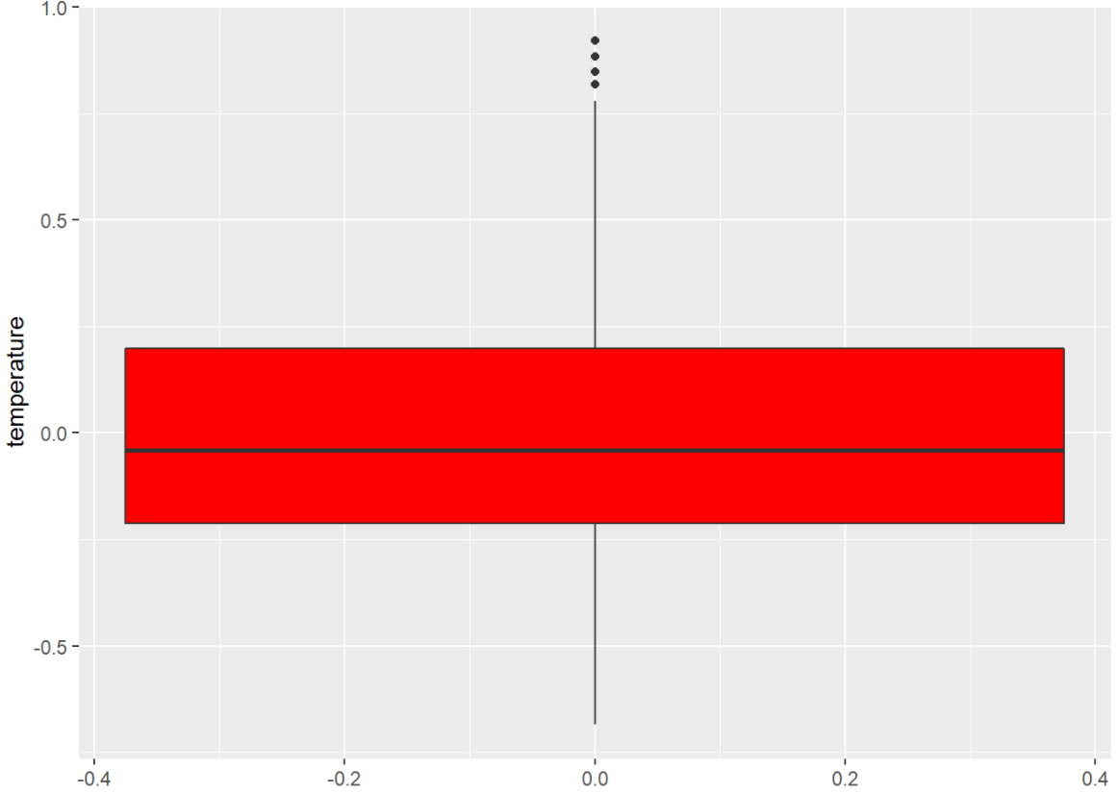
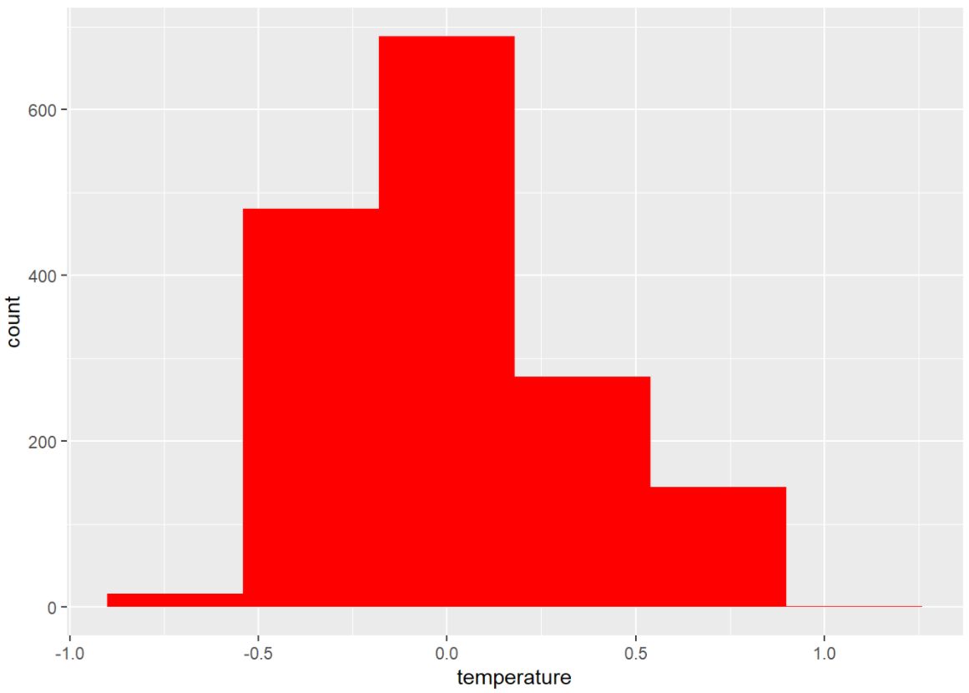
Normality and Outliers for Temperature
Notes:
This temperature dataset has 5 outliers (2 have the same value), and the distribution is the same as before. I made a new dataset after filtering out the outliers.

Slide 24
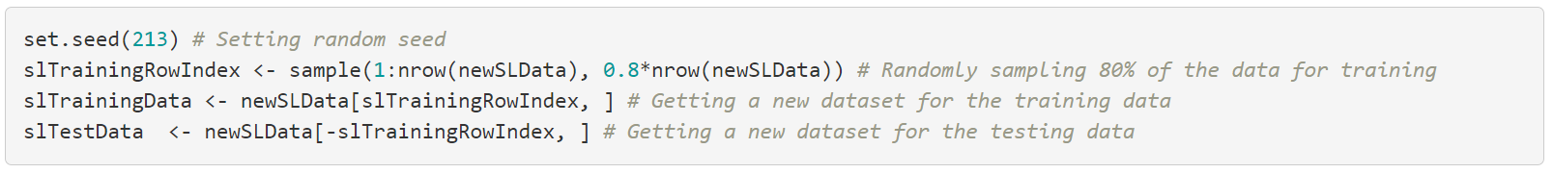
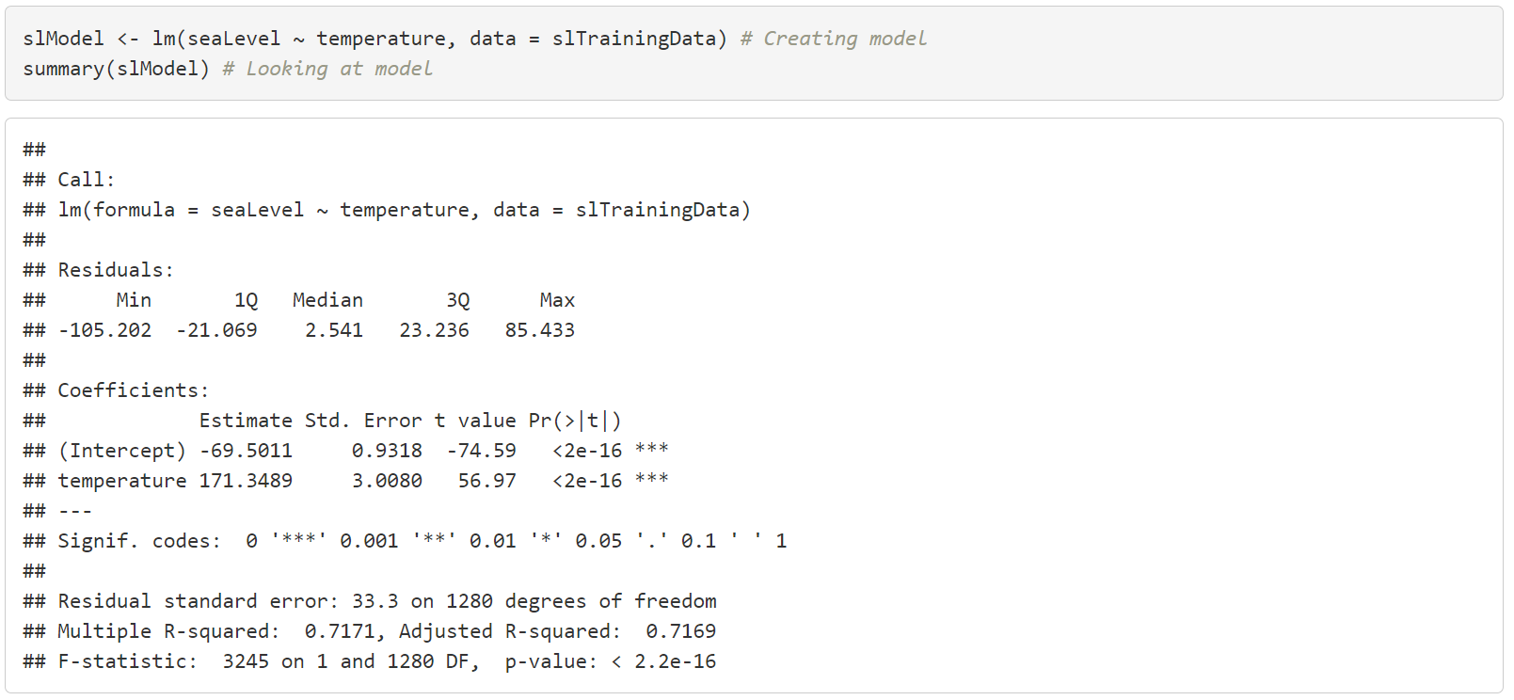
Linear Regression Model
Notes:
Next, I split the new data into training set and testing set and created a model with the training data. R-squared is about 0.72 which is okay. Median residual is 2.541 which is a lot higher than the previous but that makes sense since I am seaLevel’s range is a lot greater than that of temperature. Also, the p-value is really low so this model seems to be decent.

Slide 25
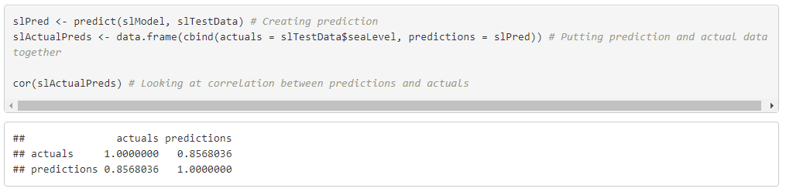
Testing Model
Notes:
The prediction has about an 86% correlation to the test case results which I think is pretty good. The graph varies more from -0.4 to 0.2 compared to the rest of the graph so that might be a part the model is further off. In general, the model should work in the future until we reach a threshold where the melting of the snow and glaciers left do not have a large impact anymore.

Slide 26
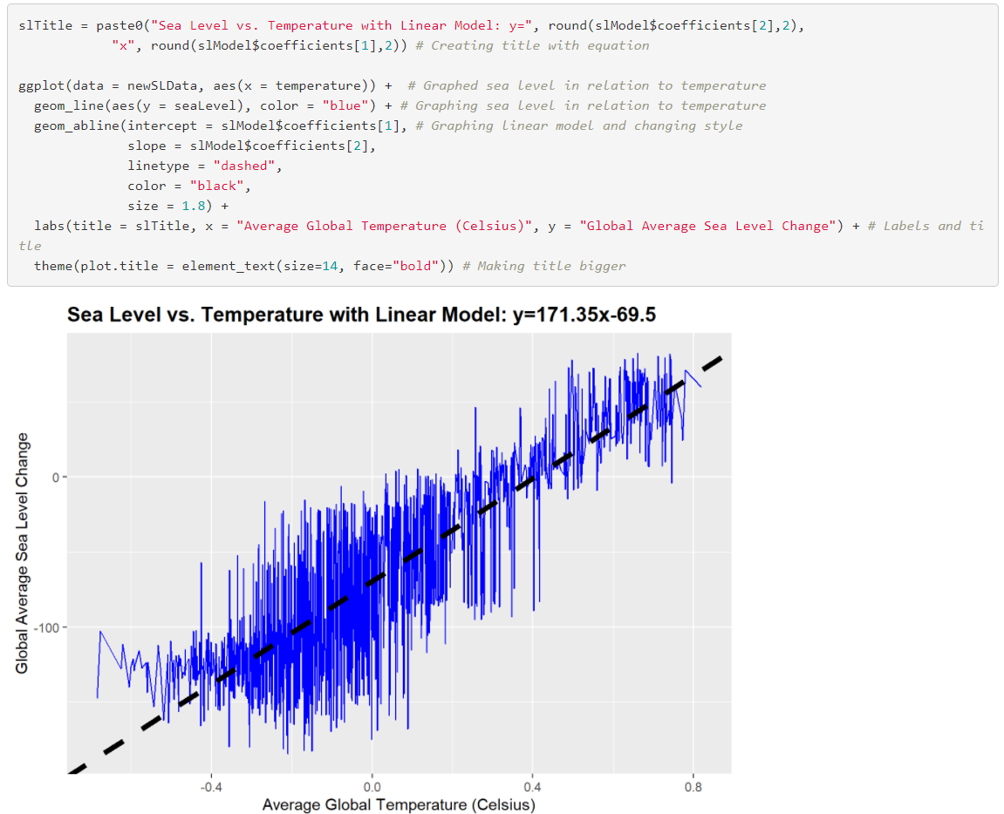
Model Graph
Notes:
Graph looks pretty good, the prediction is clearly following the trend of the actual graph. It is interesting that the beginning looks almost exponential but the later parts look more linear.

Slide 27
Hypothesis Reflection
Hypothesis
Around 0.8 for correlation between carbon levels and global temperature
Around 0.6 correlation between carbon/temperature and related weather/climate patterns
Probably low correlation between many effects and carbon/temperature.
Results
Around 0.88 correlation for carbon and temperature
Around 0.85 correlation for sea levels
Wildfires, pH, and hurricanes were all very low on correlation
Notes:
In my project, I got around 0.88 for correlation of carbon to temperature which is pretty close to what I predicted. This makes sense as carbon is one of the main green house gases that is very abundant and has a big effect on temperature. The correlation between sea levels and temperature was actually way higher than I had predicted, but the wildfires, pH, and hurricanes were all very low on correlation. For pH, the discontinuous data and the location might be the reasons for the lack of correlation. For hurricanes, I just did not have enough data so there wasn’t really any correlation with the limited data I had.

Slide 28
Sources
Used these sites for date formatting and subtraction:
https://stats.idre.ucla.edu/r/faq/how-can-i-format-a-string-containing-a-date-into-r-date-object/
https://campus.datacamp.com/courses/intermediate-r/chapter-5-utilities?ex=14#:~:text=To%20create%20a%20Date%20object%20from%20a%20simple,for%20the%2013th%20day%20in%20January%20of%201982%3A
https://campus.datacamp.com/courses/intermediate-r-for-finance/dates?ex=8

